Slide 1
DataSpark - Illuminating Insights for Global Electronics
Capstone Project – 2
By:
Sai Vaishnav J

Slide 2
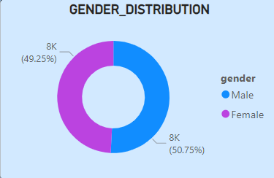
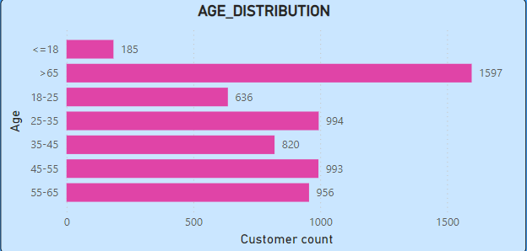
Customer Analysis
Gender Analysis:
Male customers currently outnumber female customers.
Implementing targeted advertisements aimed at female
customers could help address this imbalance and drive overall sales growth.
Age Analysis:
Customers are grouped by age buckets and visualized using a bar chart.
The analysis reveals that individuals over 65 years constitute the largest age group.

Slide 3
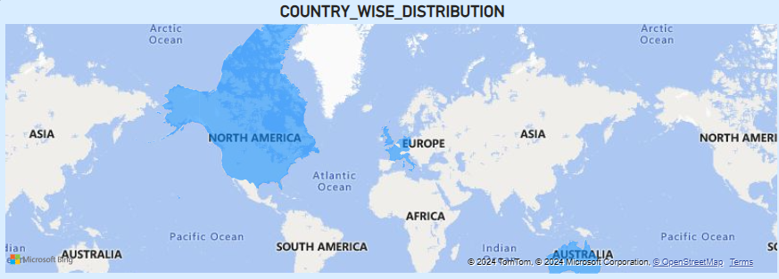
Customer Analysis
Gender Analysis:
Location-based analysis is visualized on a world map, with highlighted areas indicating sales intensity by area.
The country-level analysis shows that North America has the highest sales volume.

Slide 4
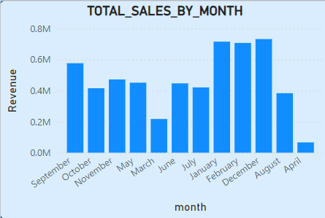
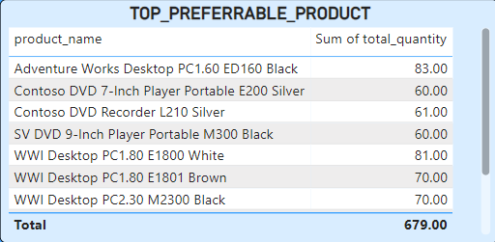
Sales Analysis
Monthly sales:
Sales peak in January, February, and December, indicating the need for adequate inventory to meet increased demand.
April and March show the lowest sales, which could be improved through targeted marketing and a well-rounded product portfolio.
Top Performers:
Computers are the top-performing category, and maintaining a well-balanced SKU selection by color is important, as there’s strong demand across a variety of colors.

Slide 5
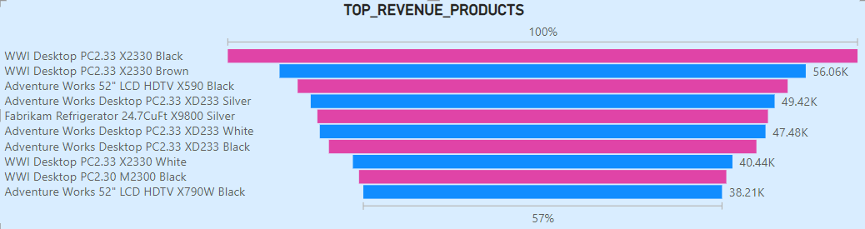
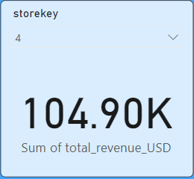
Sales Analysis
Revenue sales:
Here we can see the total list of products and their revenue of them.
According to the store keys, the revenue from each store key is shown.

Slide 6
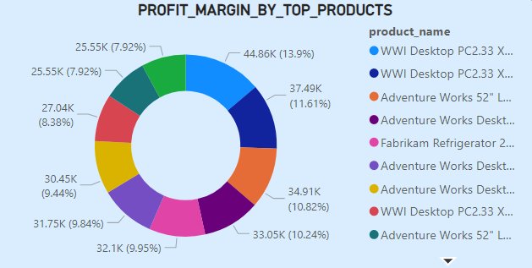
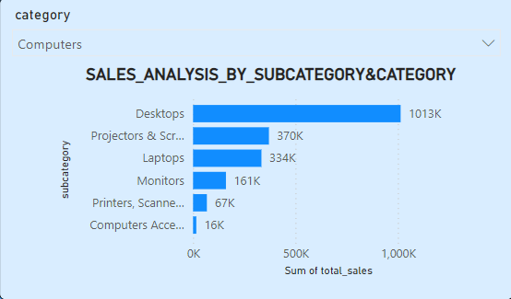
Product Analysis
Profit Margin by Top Products:
The donut chart for the top 10 products reveals a well-balanced distribution, indicating that profit margins across these products are evenly maintained, which is a positive sign.
Sales analysis by subcategory and category:
The total sales of the products have been recorded from the products listed in category and sub-category.

Slide 7
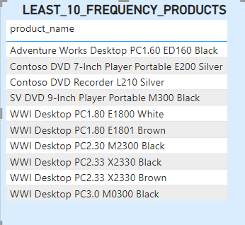
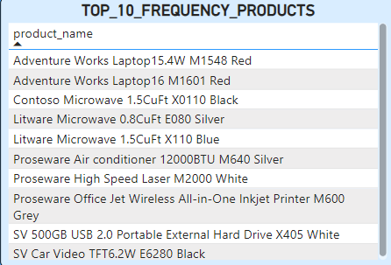
Product Analysis
Least 10 Frequency Products:
A large portion of the bottom 10 products by frequency falls within the desktop and DVD segments.
Conducting competitor analysis could help identify potential gaps in our current offerings.
Top 10 Frequency Products:
The best-selling products come from the laptop and hardisks. It's recommended to maintain ample inventory to meet customer demand.

Slide 8
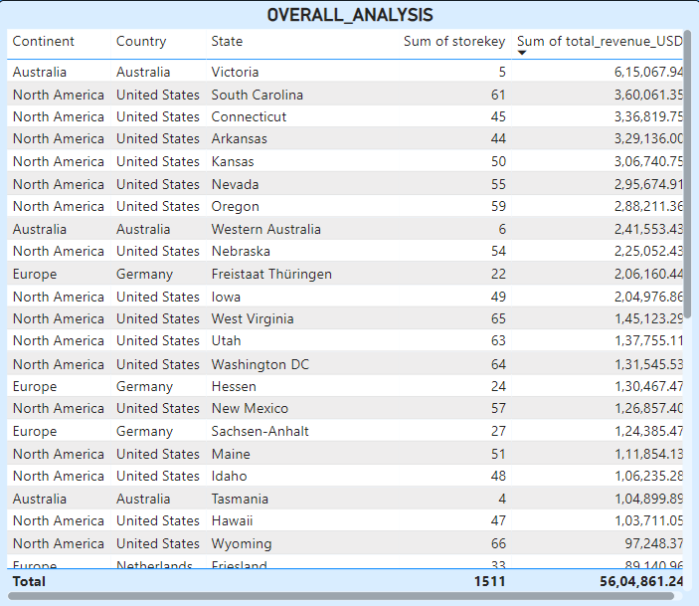
Store Analysis
Overall Analysis:
The total revenue analysis shows that North American stores lead in sales.
However, the limited number of stores in Australia may be a missed opportunity.

Slide 9
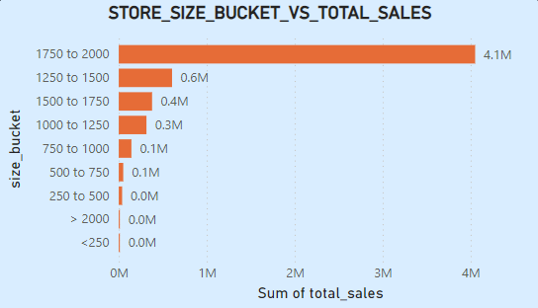
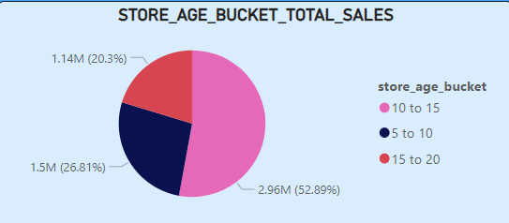
Store Analysis
Store Size Analysis:
Stores with an area between 1,750 and 2,000 square feet contribute to more than 50% of total sales. Interestingly, the largest stores do not necessarily have the highest sales figures.
Store Age Analysis:
Stores aged between 10 and 15 years generate the highest sales volume.

Slide 10
Thank You!

